Slide 1
Design Thinking
Case Study

Slide 2
Scoping
In Scope
List appointments
Present information about the patient
Log what happened
Out of scope
No full health record
No support for non Alzheimer patients

Slide 3
Research
User groups
Health visitor (basic education)
Health visitor (higher education)
Team leader
Interview with health visitor

Slide 4
Synthesize
Personae
Kim, 25 years old. Uses a smartphone every day. Works as a health visitor.
Trudi, 61 years old. Hates smartphones. Works as a Team leader.
Main features
Display and schedule appointment
Functional without continuous internet connection
Easy to use
Task list with duration
Fast access to patient information

Slide 5
Storyboards

Slide 6
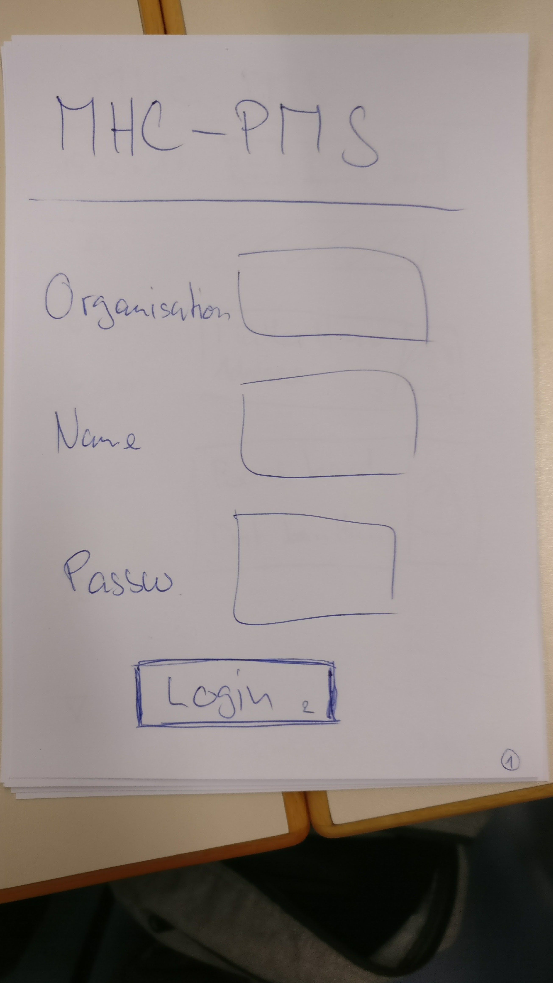
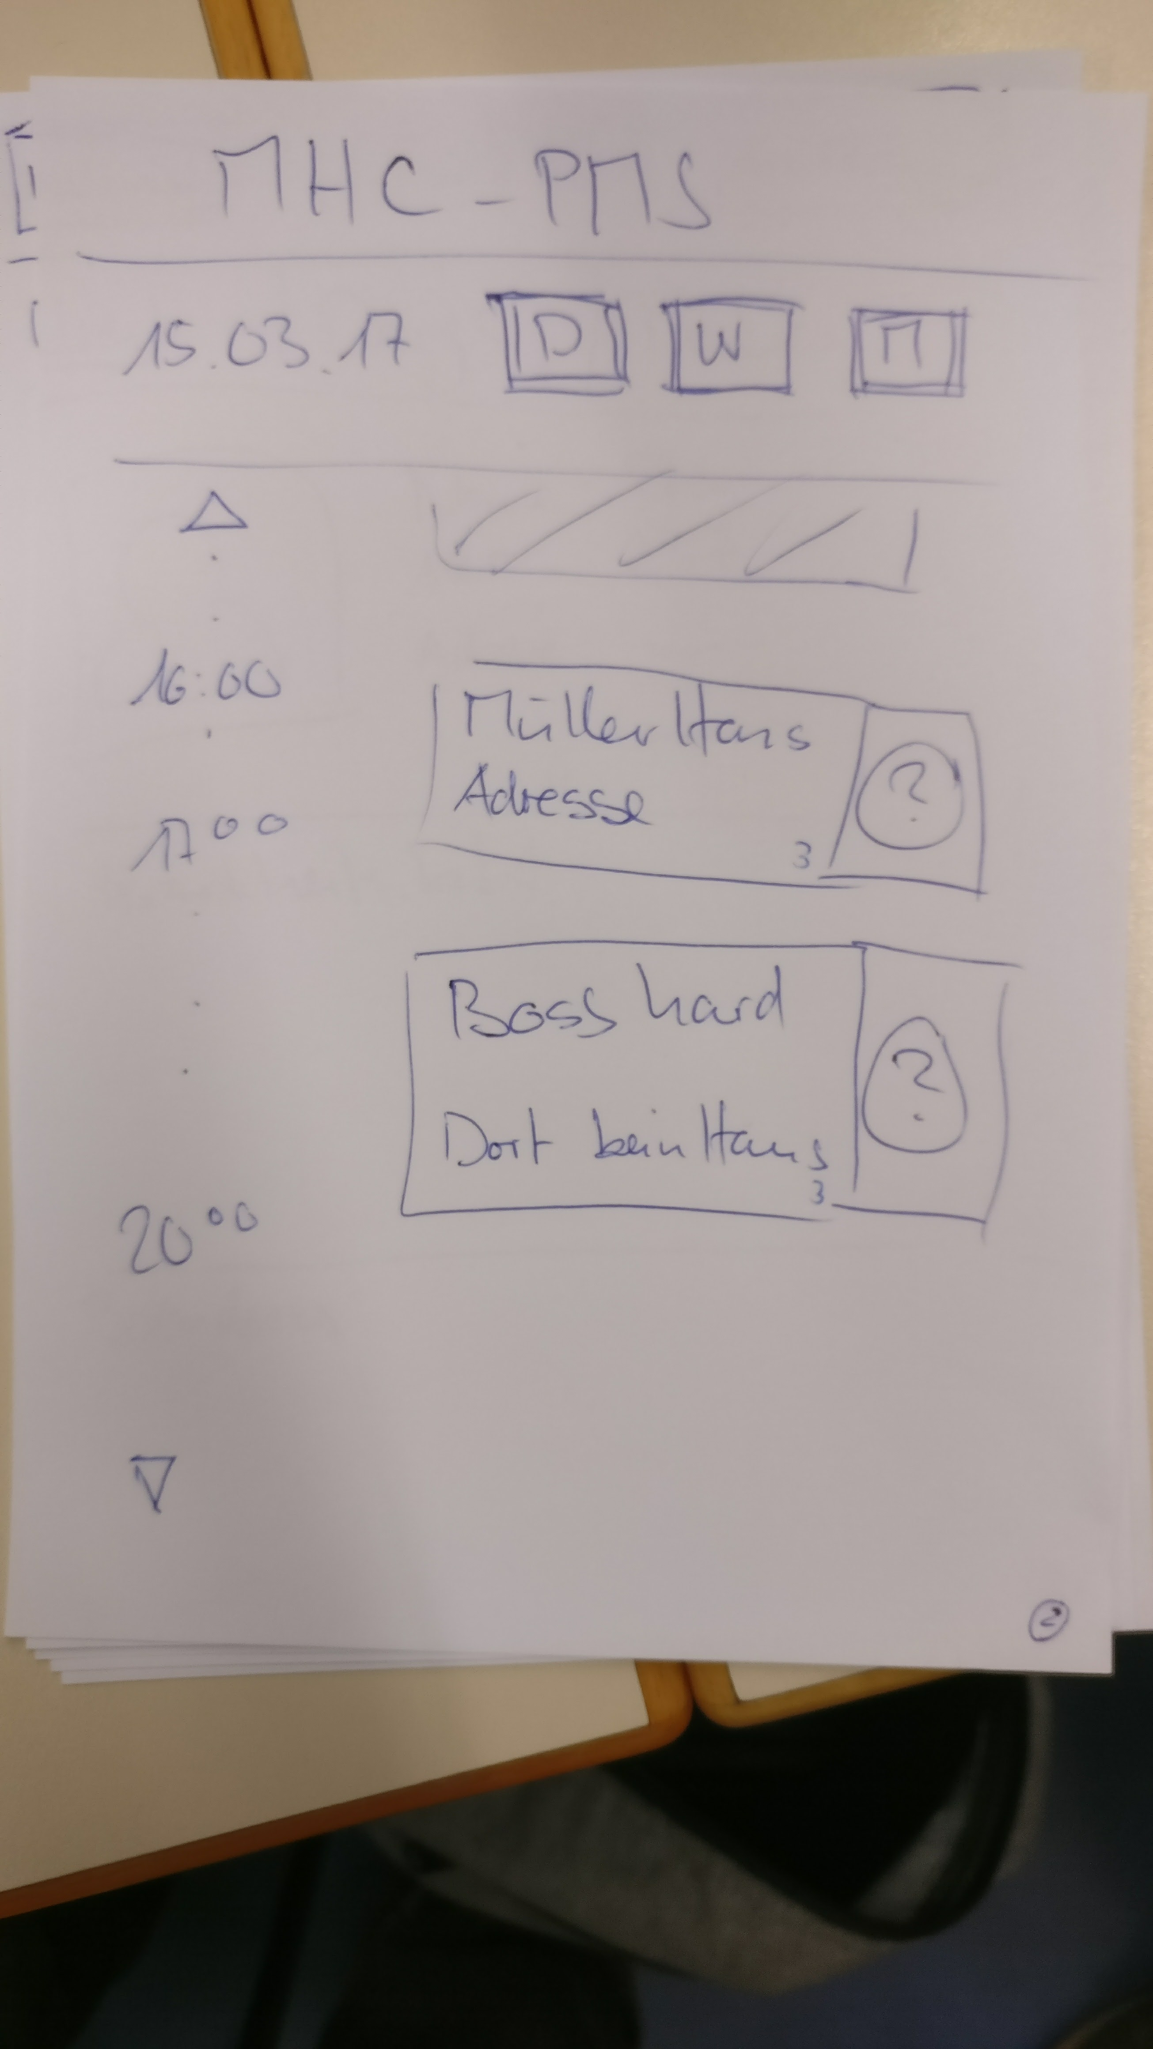
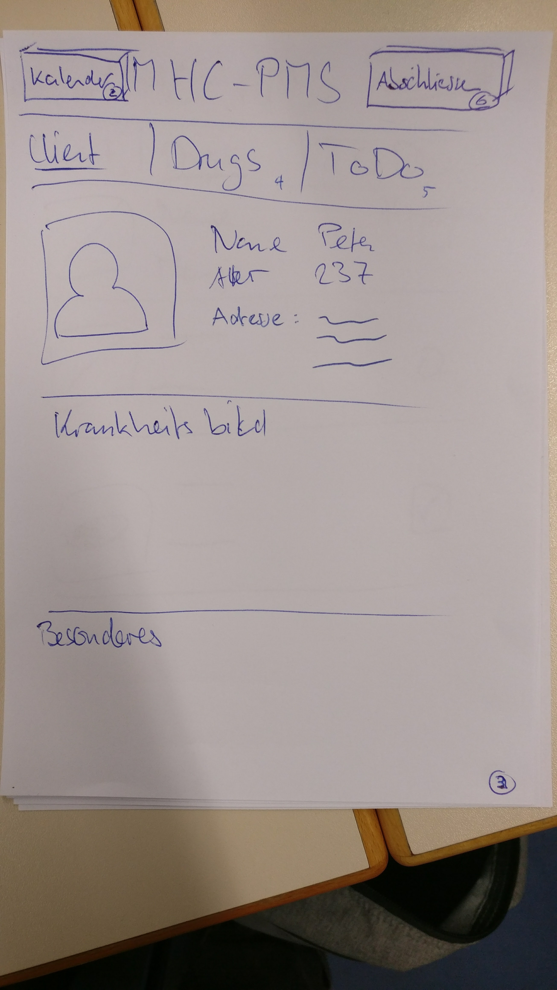
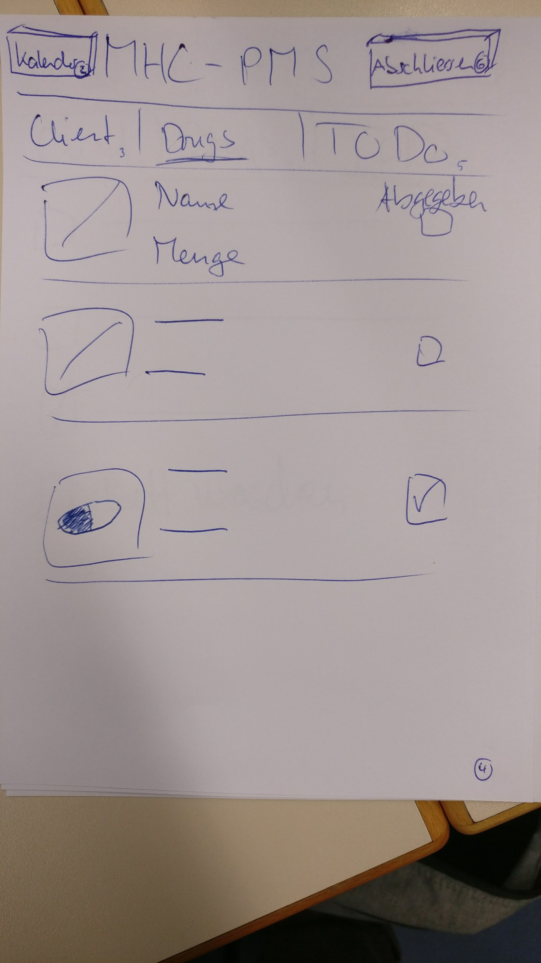
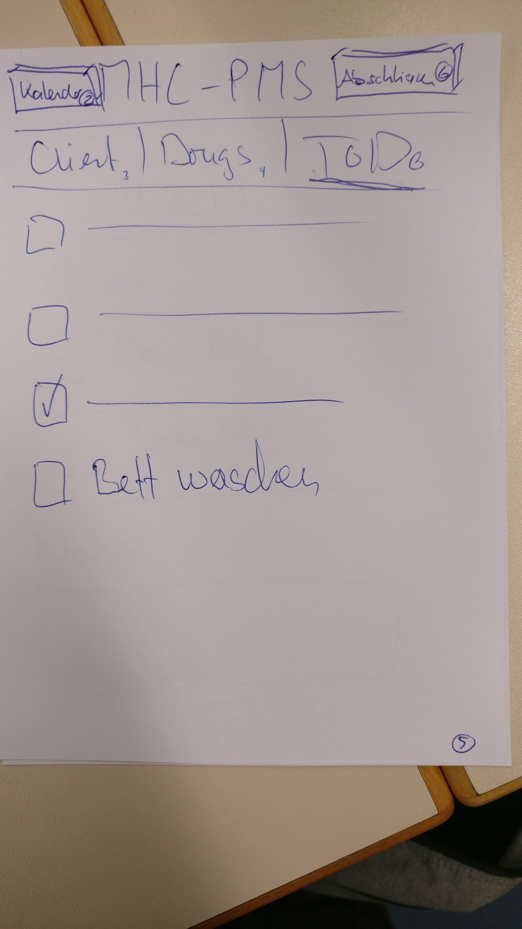
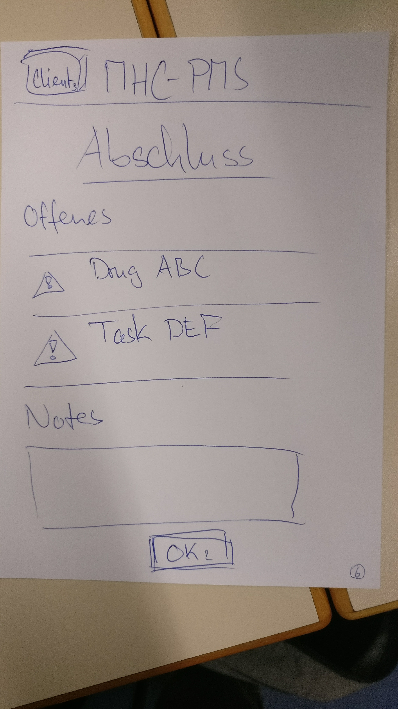
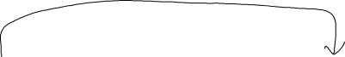
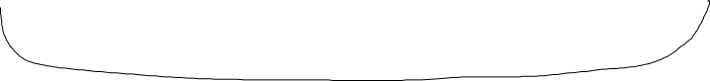

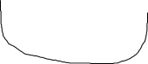

Prototype 1/3

Slide 7
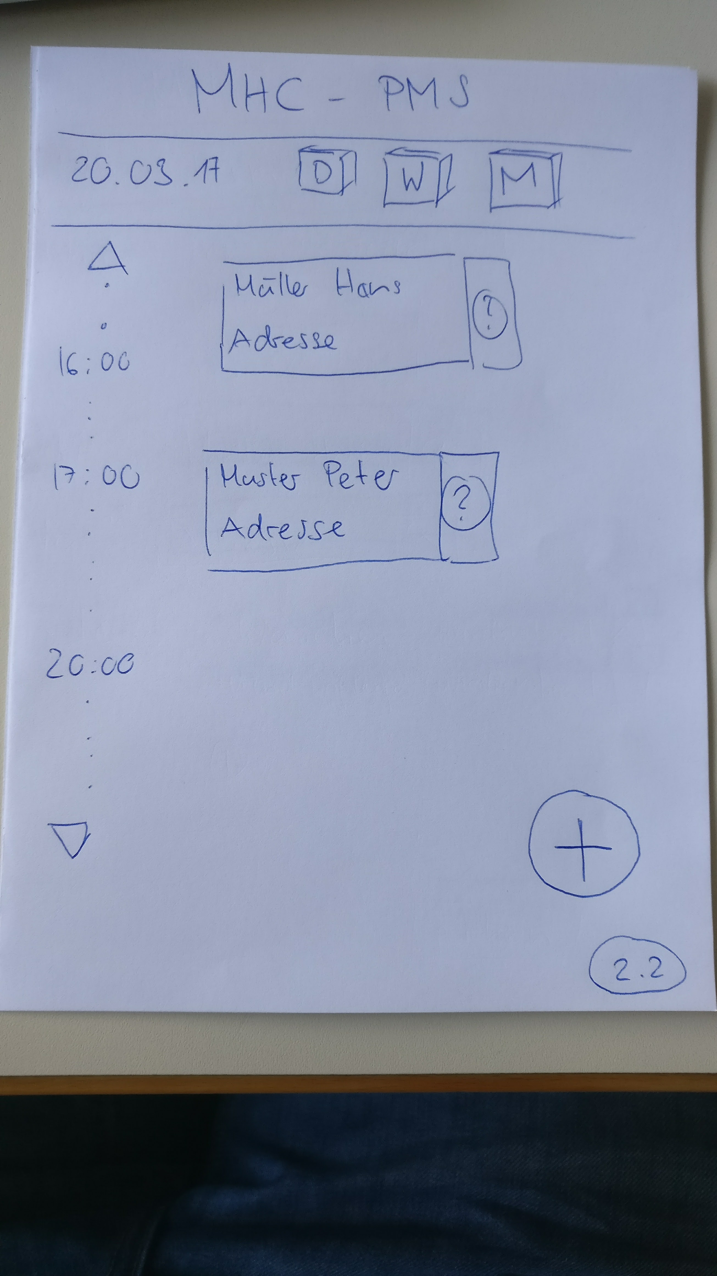
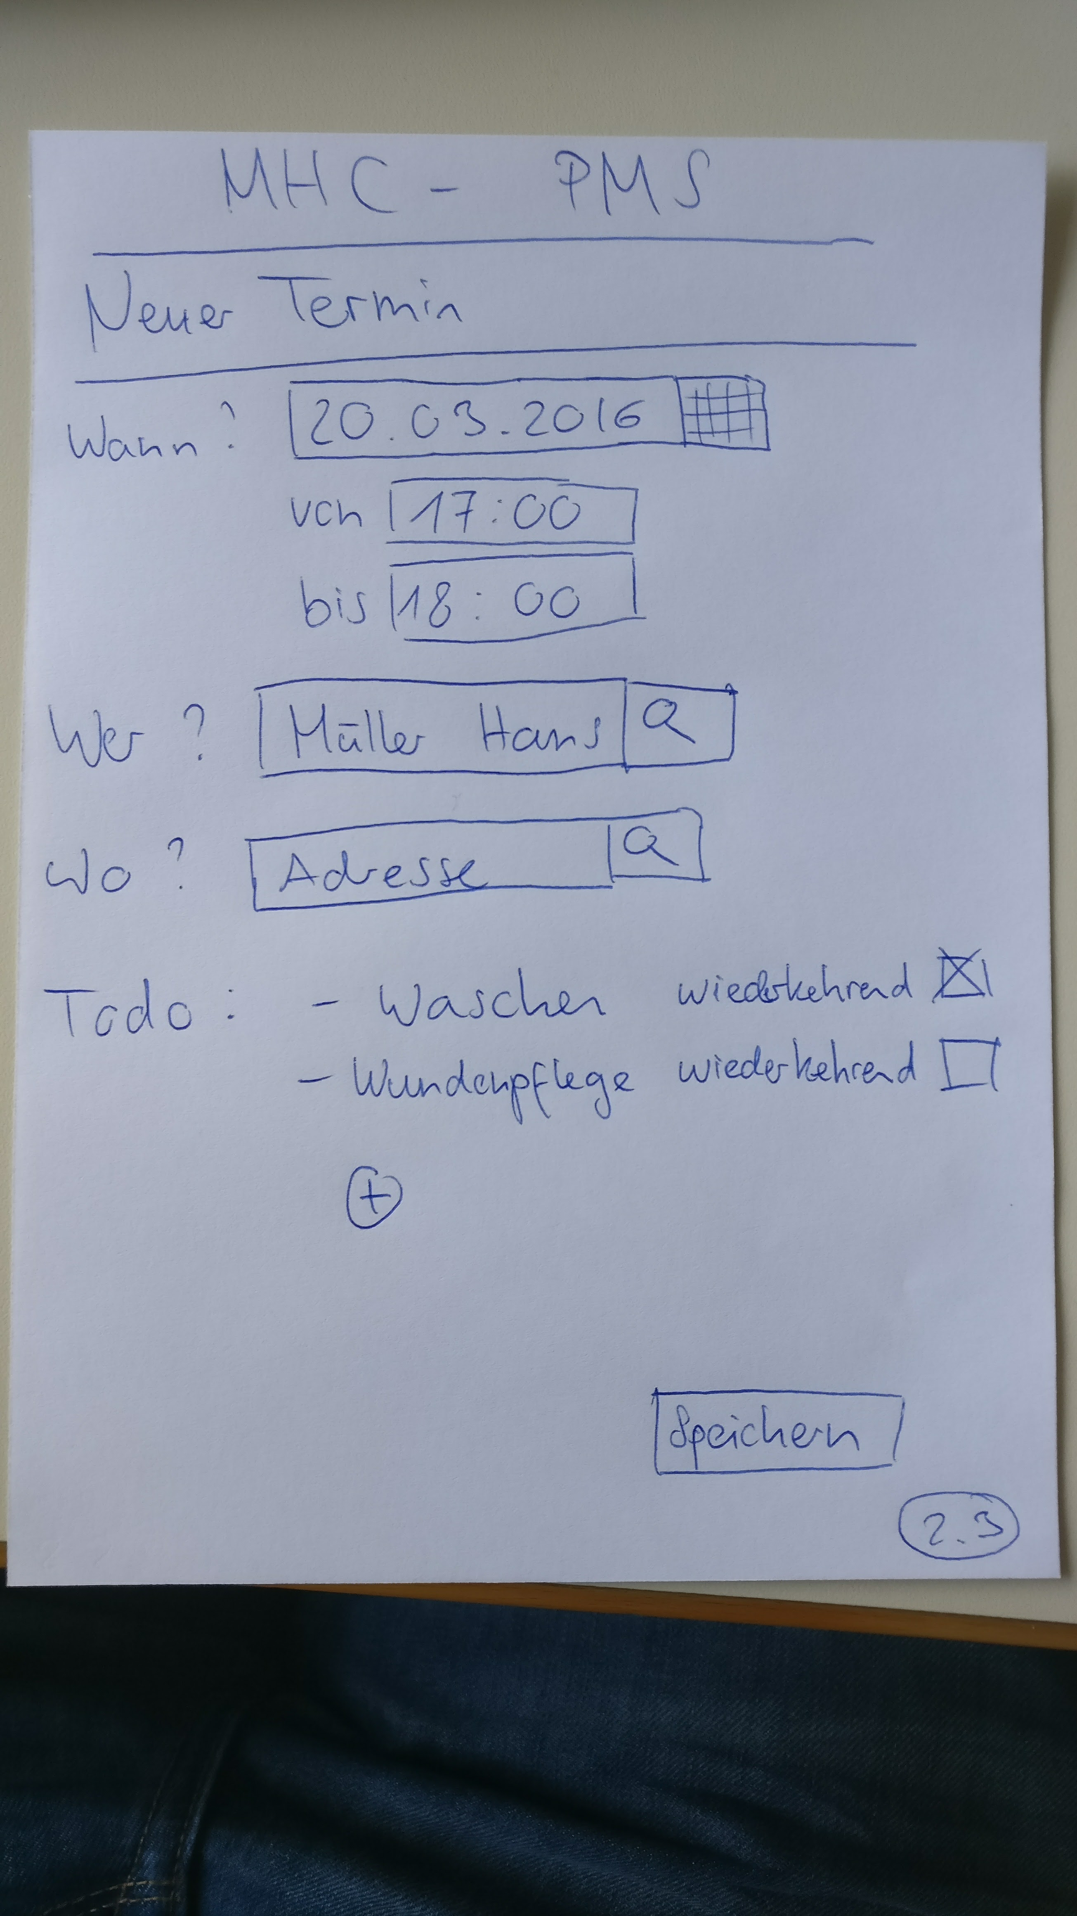





Prototype 2/3

Slide 8
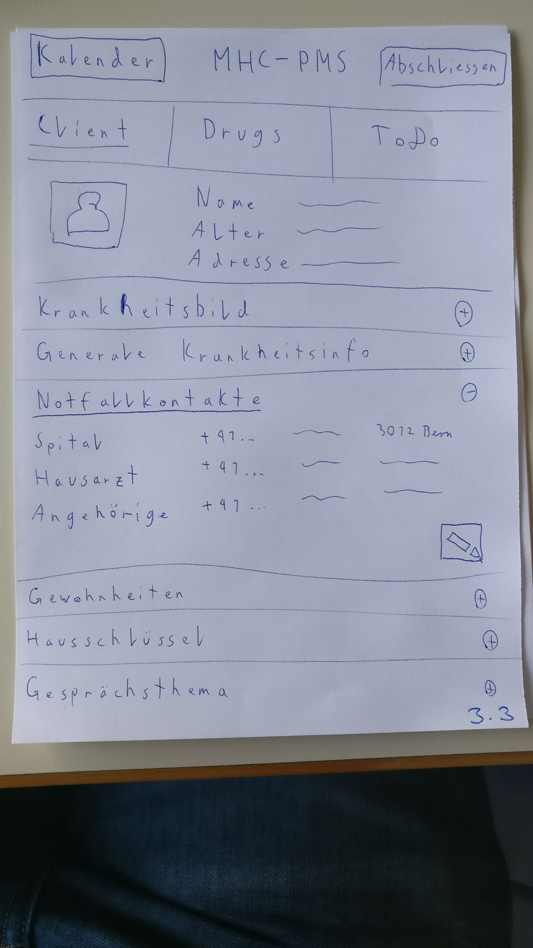
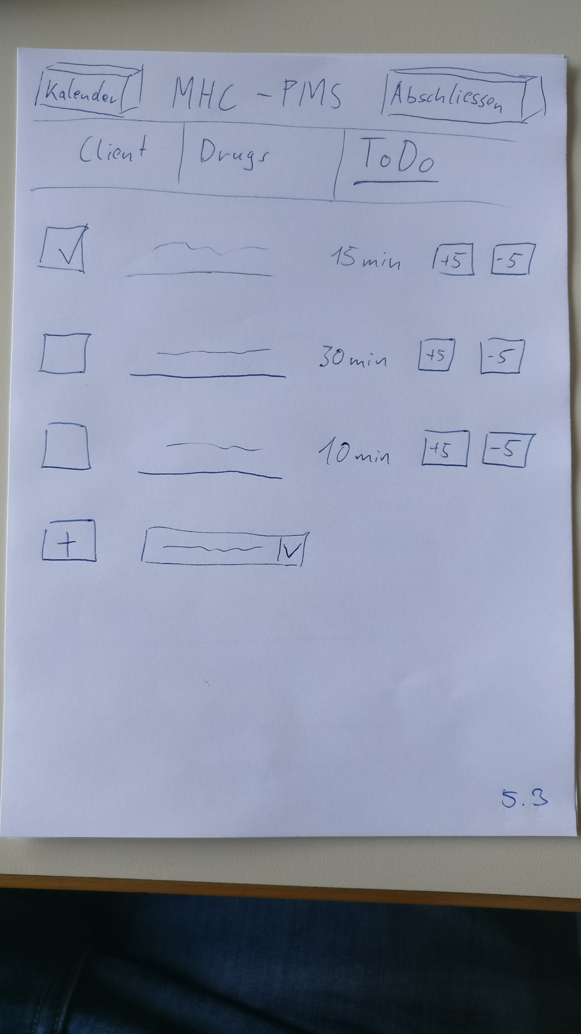
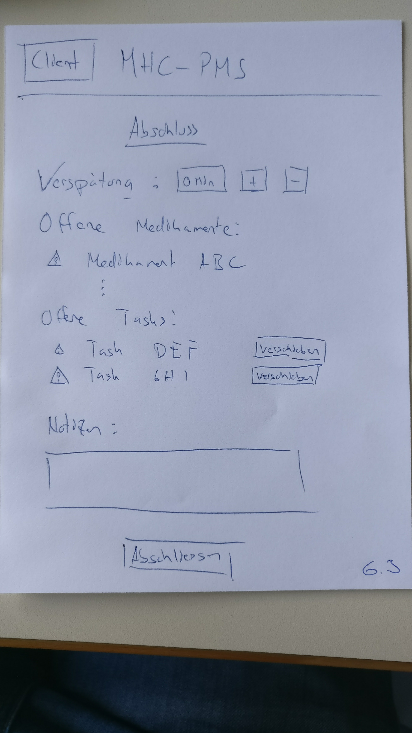

Prototype 3/3

